Slide 1

Nome:

Slide 2


Slide 3
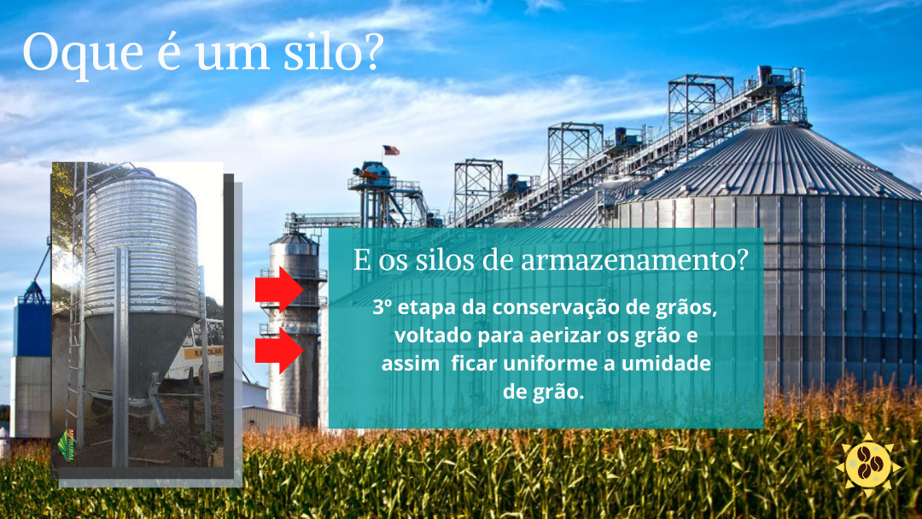

Slide 4
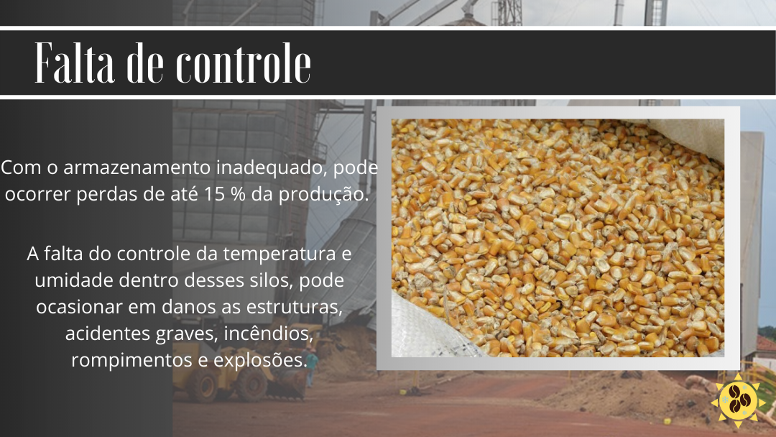

Slide 5
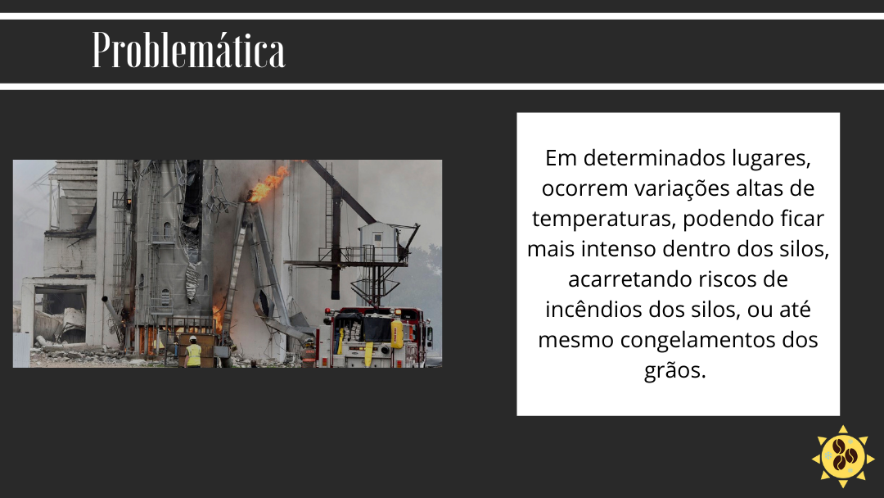

Slide 6
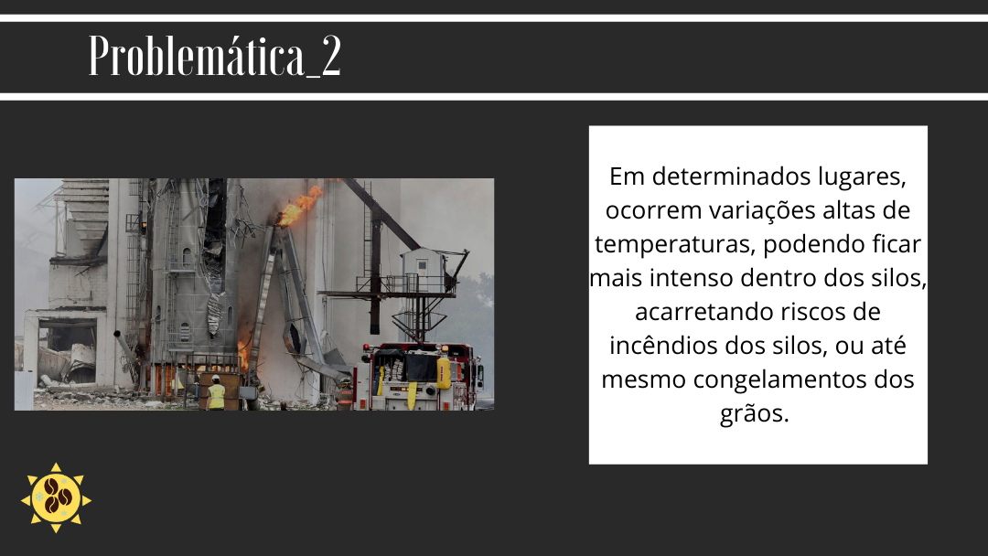

Slide 7
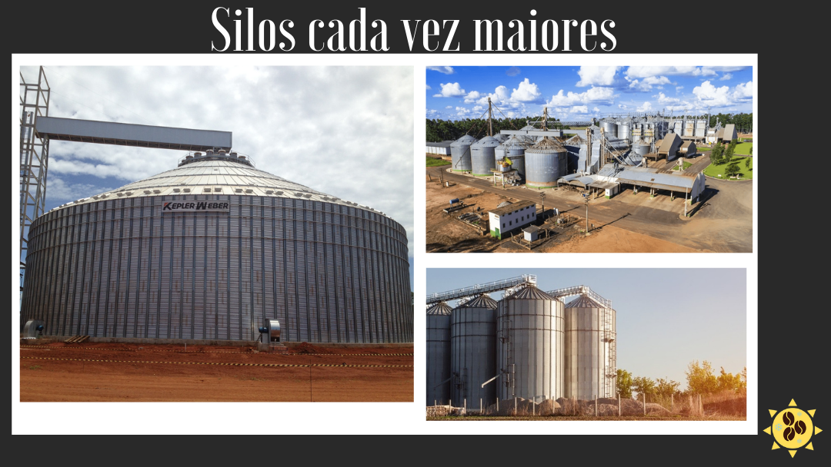

Slide 8
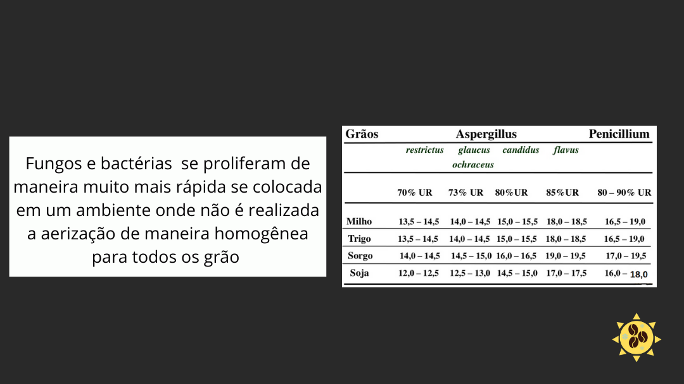

Slide 9
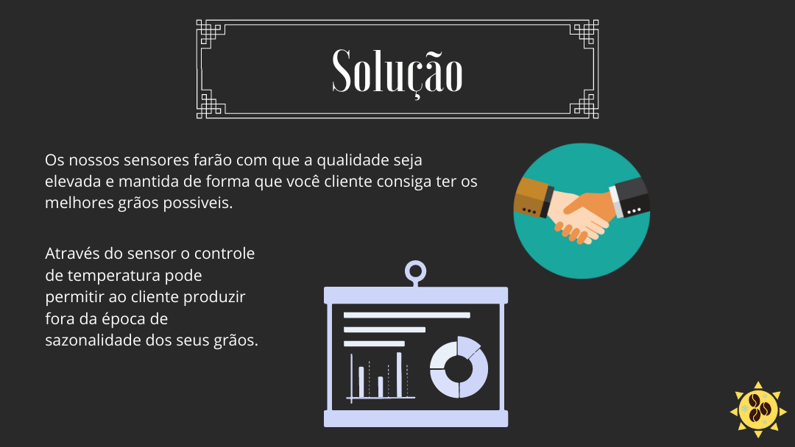

Slide 10
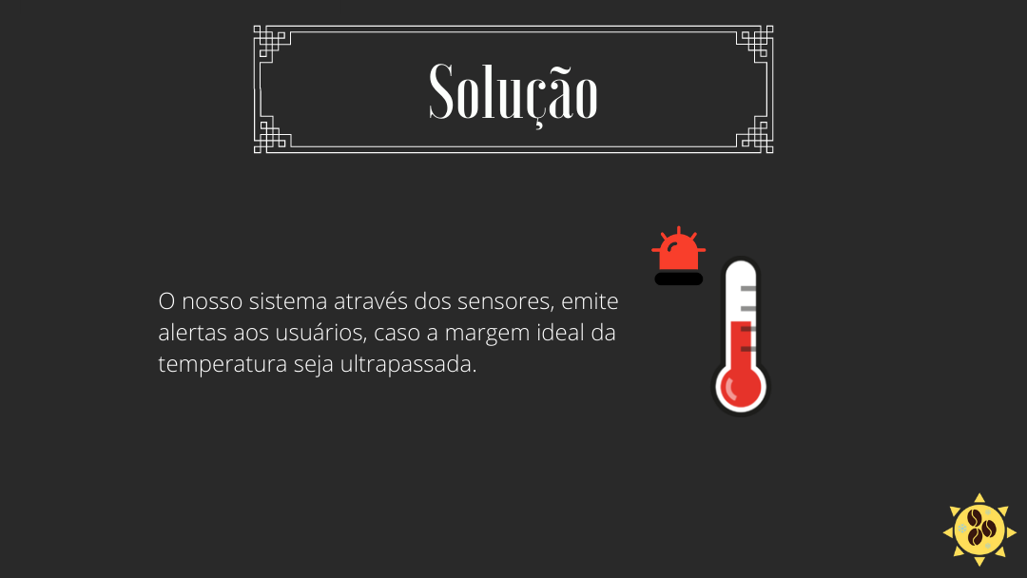

Slide 11
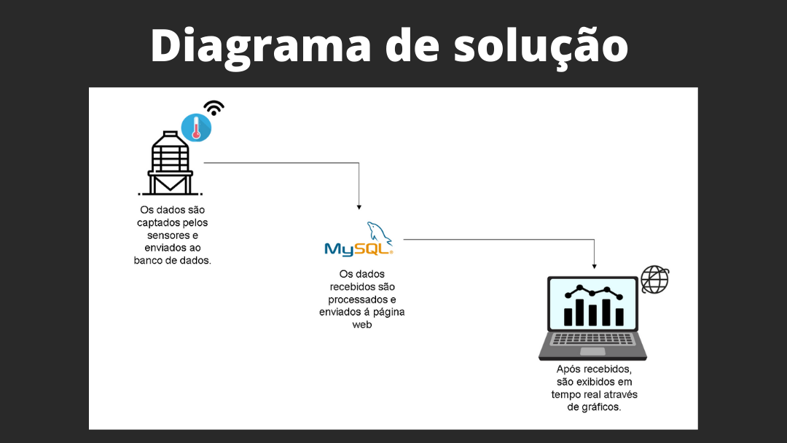

Slide 12
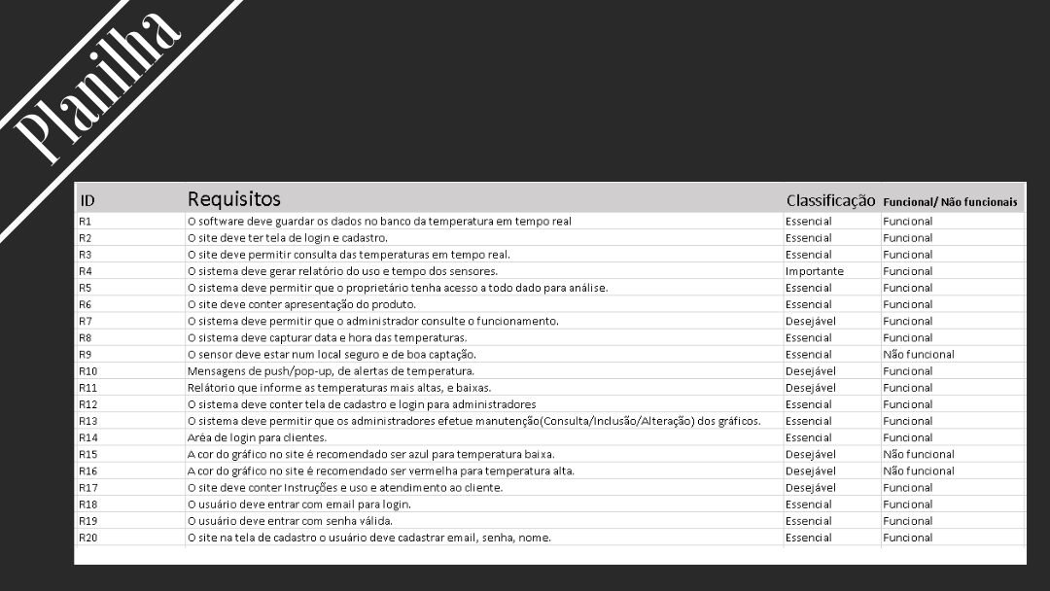

Slide 13
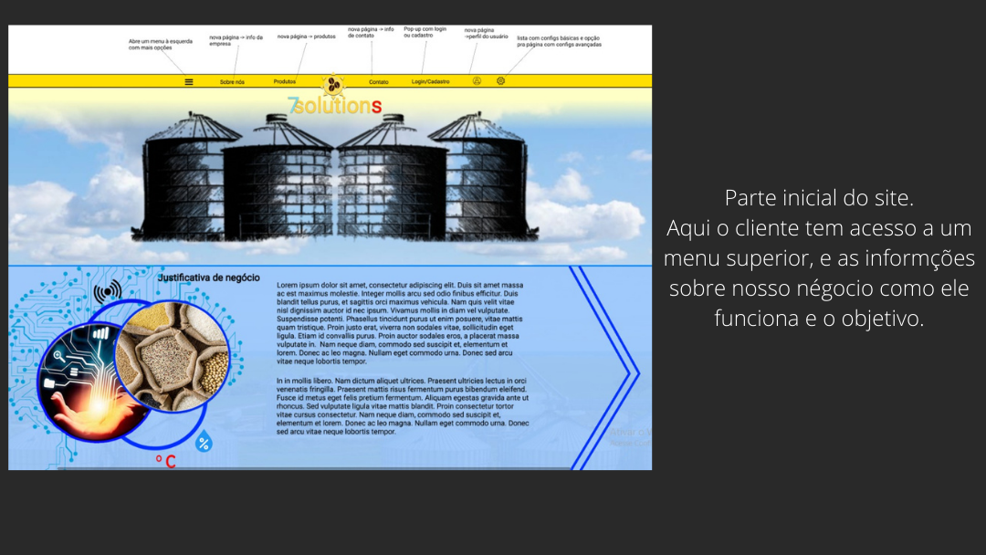
https://www.figma.com/file/GDvSwZQ876MM6Yi6dK89Jr/Untitled?node-id=0%3A1

Slide 14
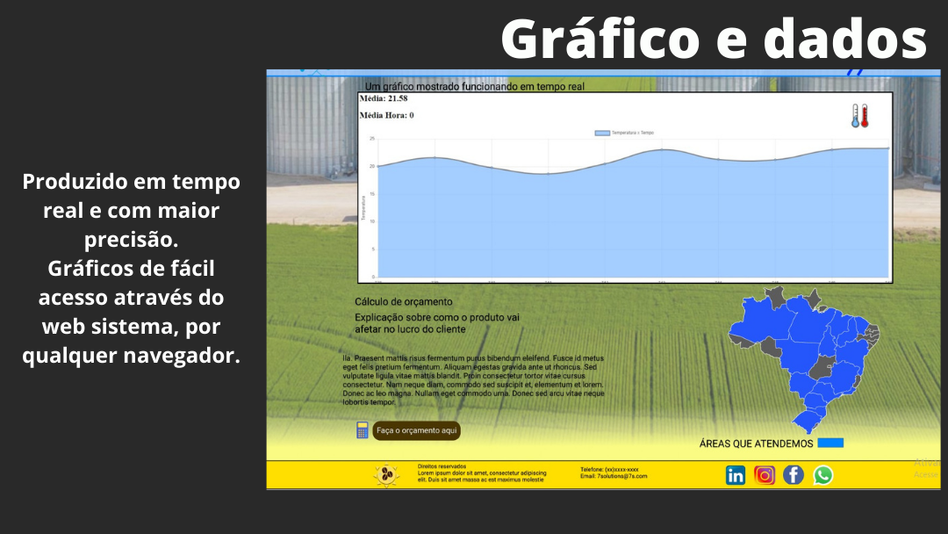
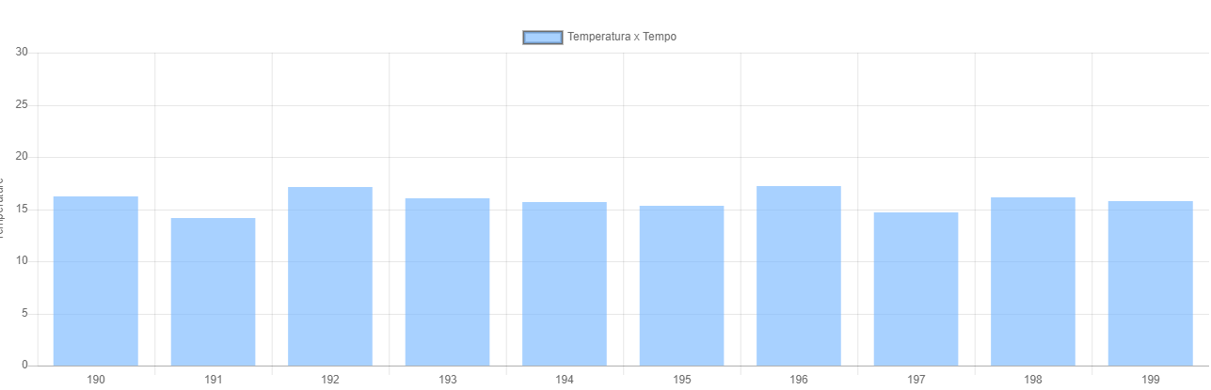
file:///C:/Users/55119/Desktop/7solution/ProjetoPi/API%20GRÁFICO/NODE4_rev1/index.html

Slide 15
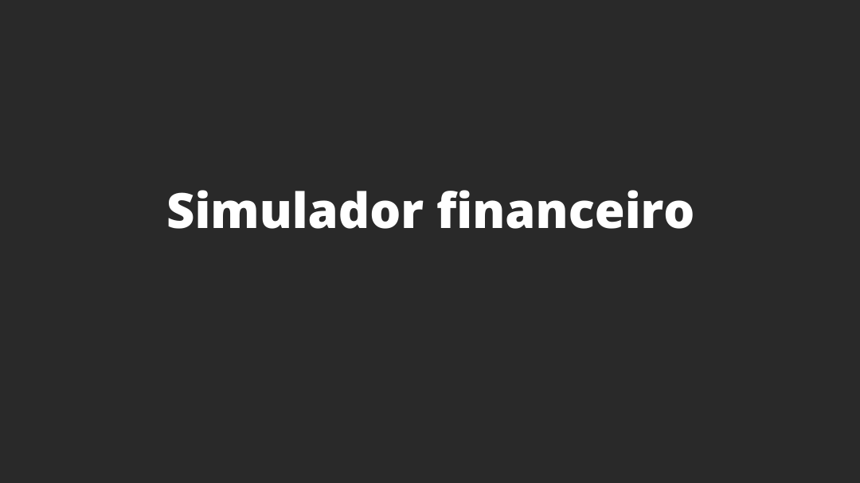

Slide 16
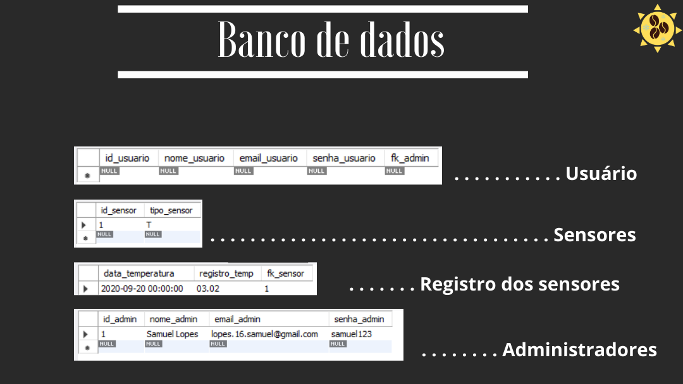
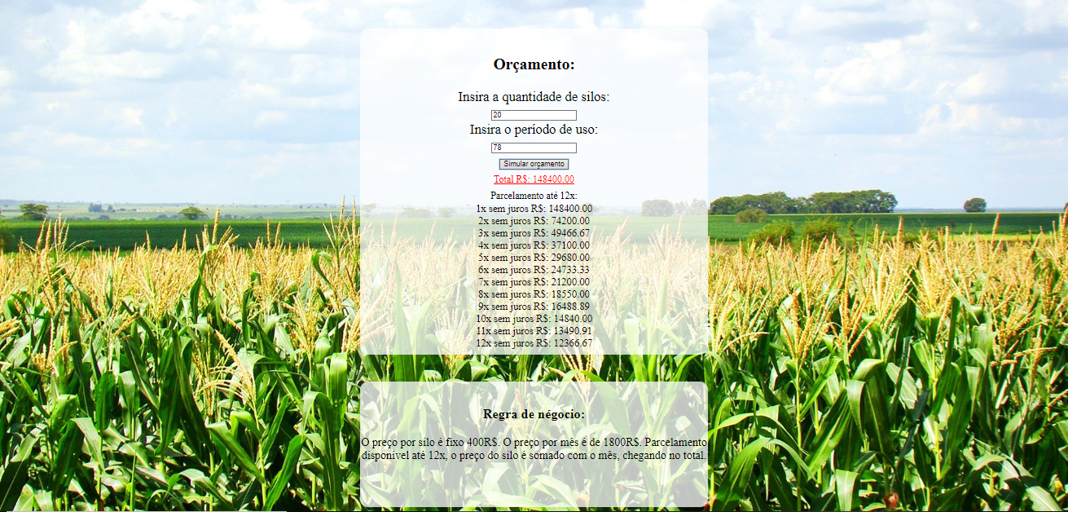
file:///C:/Users/55119/Desktop/Simulador/simulador/Simulador.html

Slide 17

Git Hub
https://github.com/GuilhermeMiranda1/ProjetoPi

